Slide 1


Decision Tree Analysis on OJ Dataset
This presentation explores the factors impacting customer purchase decisions between Citrus Hill and Minute Maid orange juice brands. We'll analyze the OJ dataset using decision tree methods, evaluating model performance and key predictors.
by Harry Depina
Notes:
Hello everyone. My name is Harry Depina, and today, I’ll be presenting an analysis of customer purchase decisions using the OJ dataset. This presentation explores the factors influencing whether customers choose Citrus Hill or Minute Maid orange juice brands, using a decision tree model to evaluate predictive factors and model performance."

Slide 2

Dataset Overview
1
Sample Size
1,070 observations of orange juice purchases, providing a robust dataset for analysis.
2
Prediction Goal
Determine whether a customer chooses Citrus Hill or Minute Maid based on various factors.
3
Key Features
Price, Brand Loyalty, and Store Type serve as primary predictors in our model.
Notes:
The OJ dataset consists of 1,070 observations, each representing an individual purchase of orange juice. Our goal is to predict whether a customer chooses Citrus Hill or Minute Maid based on several key factors. The primary features include price, brand loyalty, and the type of store where the purchase was made. We used a 70-30 data split, where 70% of the data was used to train the decision tree model, and the remaining 30% was used for testing. This approach helps evaluate the model’s generalization capability when making predictions on unseen data

Slide 3
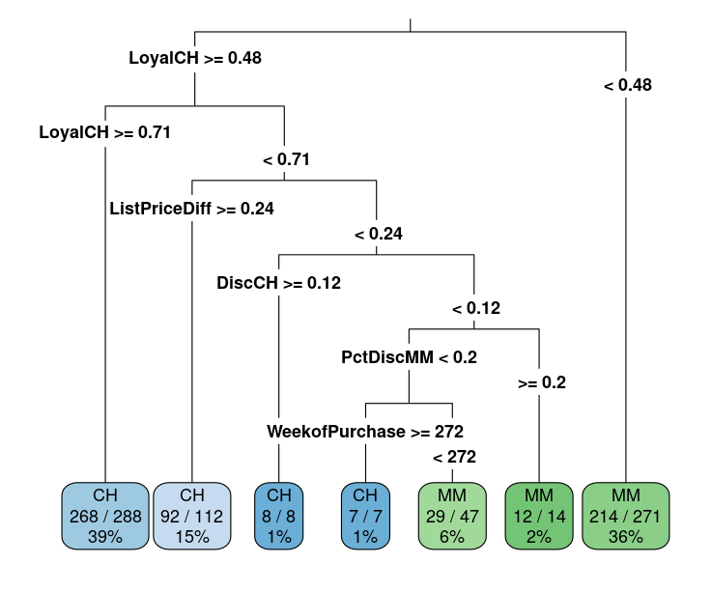



Decision Tree Visualization
Root Node: Brand Loyalty
The most influential factor in predicting orange juice brand choice.
Secondary Splits
Price differences and store-related variables further refine predictions.
Terminal Nodes
Represent predicted classes (CH or MM) with associated probability estimates.
Notes:
"Here, we have the decision tree visualization. The root node, or the first split, is based on brand loyalty, which emerged as the most influential factor in predicting which brand customers would purchase. If a customer demonstrated high loyalty towards one brand, the model classified them accordingly. Subsequent splits further refine the predictions based on factors like price differences and store-related variables, such as whether discounts were applied to one brand over the other.
The terminal nodes represent the predicted class—either Citrus Hill or Minute Maid. Each terminal node provides probability estimates, indicating the model's confidence in its predictions. This hierarchical structure allows us to understand the decision-making process step by step, based on the characteristics of the customers."

Slide 4
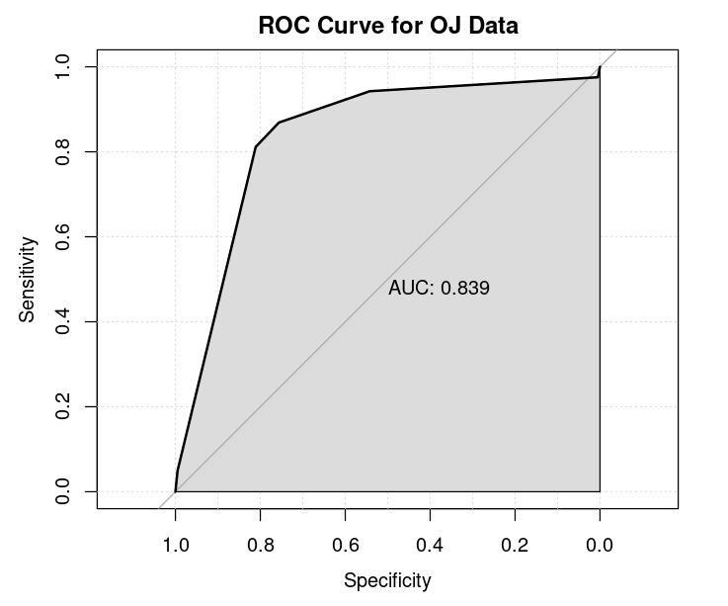
Model Evaluation
Accuracy
Measured by correct prediction rate on training data. Indicates model's basic performance.
ROC Curve
Visualizes trade-off between true positive and false positive rates across thresholds.
AUC Score
0.839 indicates good model performance in differentiating between the two brands.
Notes:
To assess the model's performance, we used several evaluation metrics. The accuracy was 84.2%, meaning the model correctly predicted the purchase outcome in 84.2% of cases on the training data. While accuracy provides a basic understanding of model performance, it doesn't capture the entire picture, especially when there may be an imbalance between the classes.
Therefore, we also used the ROC curve to evaluate the model's ability to differentiate between the two brands. The Area Under the Curve, or AUC, was 0.839, indicating good model performance. An AUC score close to 1 suggests that the model is highly effective in distinguishing between Citrus Hill and Minute Maid purchases, while a score closer to 0.5 would indicate performance no better than random guessing."

Slide 5

Model Performance Summary
Metric
Value
Interpretation
AUC Score
0.839
Good discrimination
Accuracy
84.2%
Solid predictive power
F1 Score
0.83
Balanced precision and recall
Notes:
The decision tree analysis identified several key factors influencing purchase behavior. Brand loyalty was the most significant predictor, which aligns with what we know about consumer behavior: customers who are loyal to a brand are more likely to stick with it, even when competing options are available. Price was another important factor, with significant price differences swaying decisions even among loyal customers. This suggests that competitive pricing strategies could be effective in attracting customers from rival brands.
The retail environment also played a role, with certain store types or promotional settings impacting customer choices. For example, discounts or special offers in certain stores could tip the balance in favor of one brand over the other."

Slide 6

Conclusion and Future Steps
Key Findings
Brand loyalty, pricing, and store characteristics are main drivers behind purchase decisions.
Model Effectiveness
AUC score of 0.839 indicates good performance, but there's room for improvement.
Refinement Strategies
Consider pruning or different splitting criteria to enhance model accuracy.
Feature Expansion
Incorporate customer demographics or seasonal factors for more nuanced predictions.
Notes:
In conclusion, the decision tree model helped us understand the primary drivers behind customer purchasing decisions for orange juice. Brand loyalty emerged as the most influential factor, followed by price and store characteristics. The model performed reasonably well, with an AUC score of 0.839 and an accuracy of 84.2%, but there is still room for improvement.
Future steps could include refining the model through pruning to prevent overfitting or experimenting with different splitting criteria. Additionally, incorporating more features, such as customer demographics or seasonal trends, could provide a more nuanced understanding of purchase behavior. This could help further enhance the predictive power of the model and offer deeper insights into consumer preferences.

